Slide 1

What is IOT ?
IoT is simply the network of interconnected things/devices which are embedded with sensors, software, network connectivity and necessary electronics that enables them to collect and exchange data making them responsive.

Slide 2
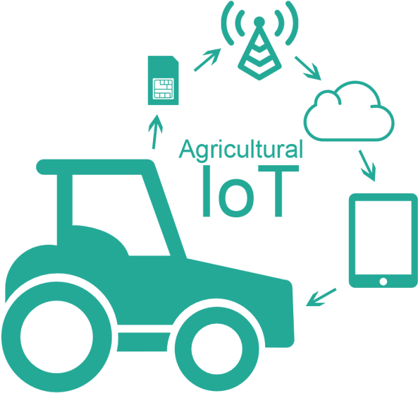
Example
Interconnected things and devices.
Sensor ,Software and Network connectivity
Collection and exchange of data

Slide 3


Slide 4
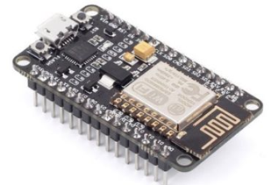
What is NodeMCU?
Singleboard WIFI Enabled microcontroller.
Has Various pins for communication .
Its programmable uses LUA scripting language Or Arduino IDE.

Slide 5
What is Microcontroller?
A microcontroller is a compact integrated circuit designed to govern a specific operation in an embedded system. A typical microcontroller includes a processor, memory and input/output (I/O) peripherals on a single chip.

Slide 6
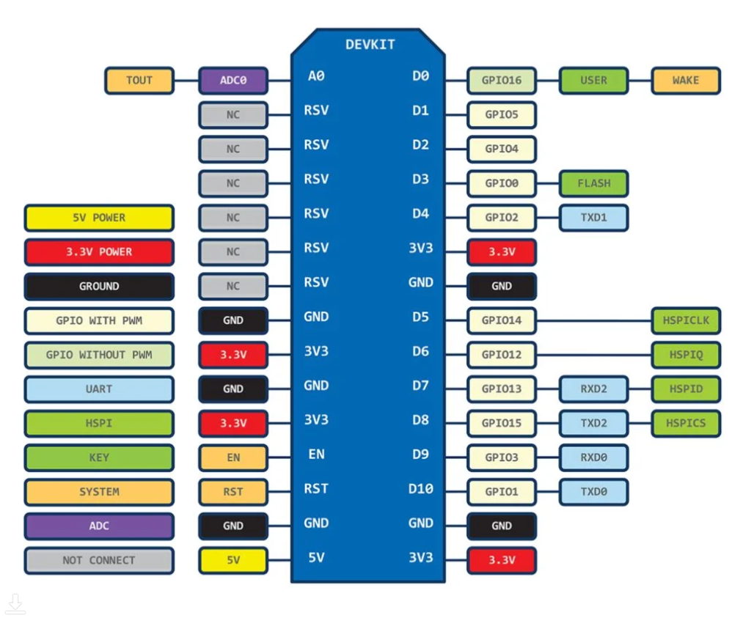
PIN Confeguration

Slide 7
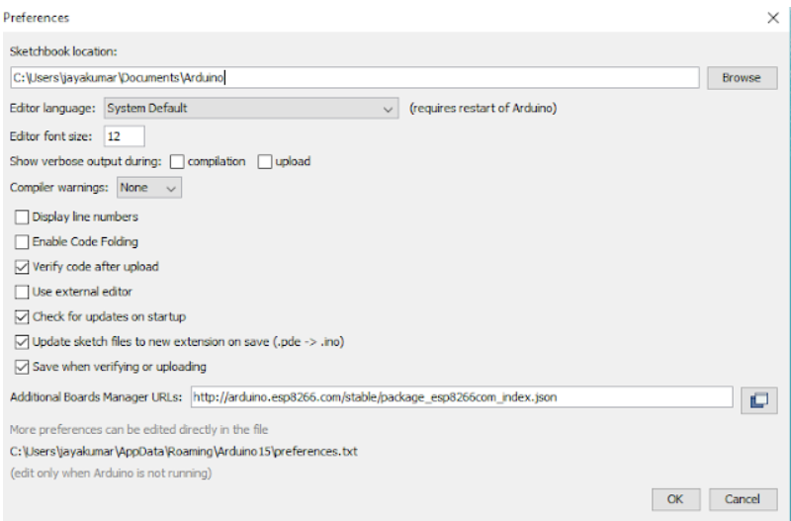
Installation of NodeMCU board
In Arduino IDE
Go to files and click on the preference in the Arduino IDE
Paste the link in additional board manager URL

Slide 8
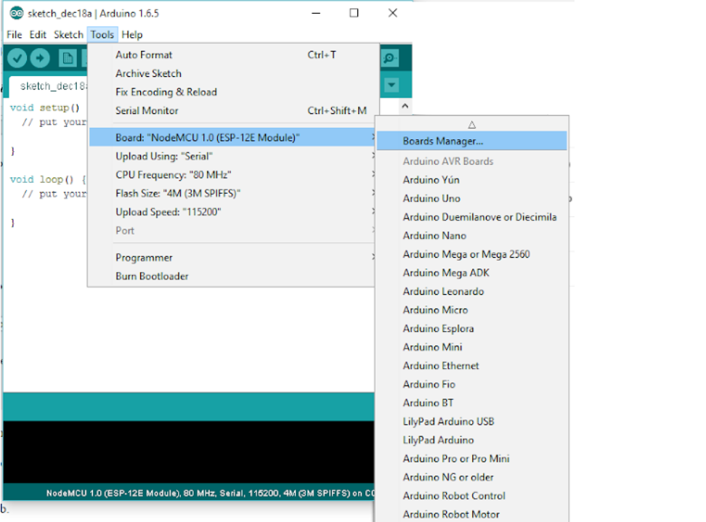
Go to Tools and then to the board manager and search for ESP8266 and install it

Slide 9

Breadboard
A breadboard is a solderless device for temporary prototype with electronics and test circuit designs.
Horizontally Interconnected
Vertically Interconnected

